Slide 1
Introduction to CLV
Lecture 5
Customer Analytics

Slide 2
Agenda
CLV
Case 1: new customer
Case 2: existing customer
Case 3: new customer, profits come at the end

Slide 3
CLV
Revenues less costs of marketing, selling, production, servicing
Conceptual definition:
the present value of the future profits associated with a particular customer
Uncertain from today’s perspective—
it’s a forecast/prediction!
Time value of money:
€1 today > €1 tomorrow
Only include costs attributable
to the individual customer

Slide 4
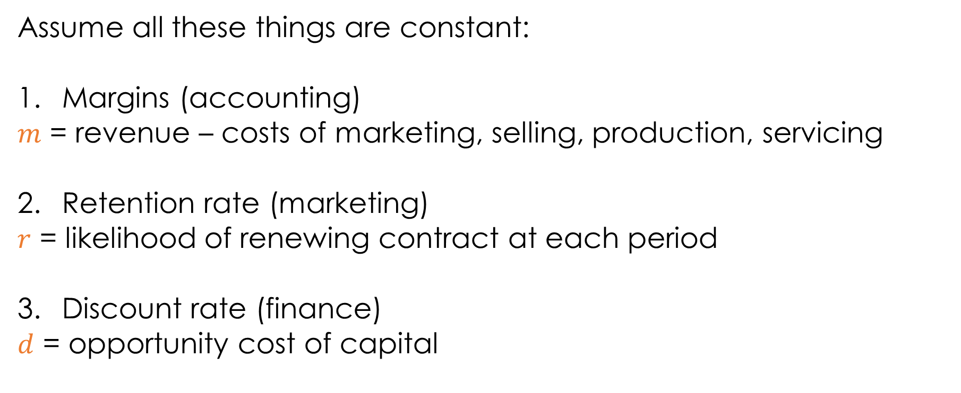
Traditional approach
Assume all these things are constant:
Margins (accounting)
$m$ = revenue – costs of marketing, selling, production, servicing
Retention rate (marketing)
$r$ = likelihood of renewing contract at each period
Discount rate (finance)
$d$ = opportunity cost of capital

Slide 5
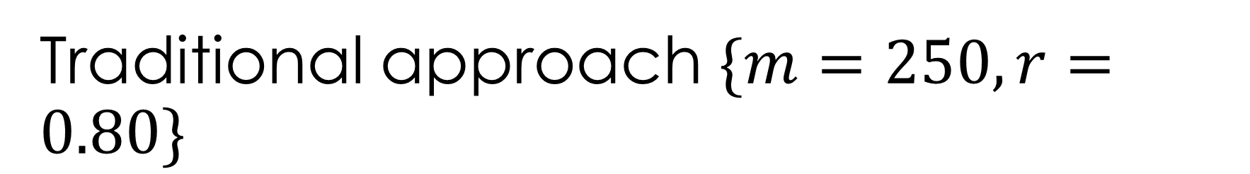
Traditional approach $\{m=250, r=0.80\}$
Discounted to Present
1/(1+d)¹
1/(1+d)²
1/(1+d)³
1/(1+d)⁴
Expected Revenue
$250
$200
$160
$128
$103
Probability of Still Being “Alive”
.8
.64
.51
.41
Margin
$250
$250
$250
$250
$250
…
3
Time (0 is present)
0
2
4
1
Period 1
Period 2
Period 3
Period 4
Receive €m when contract is initiated at t = 0; customer renews at beginning of period 2 with probability r, in which case we receive another €m discounted by 1/(1+d)

Slide 6
Traditional approach $\{m=250, r=0.80\}$
Discounted to Present
1/(1+d)¹
1/(1+d)²
1/(1+d)³
1/(1+d)⁴
Expected Revenue
$250
$200
$160
$128
$103
Probability of Still Being “Alive”
.8
.64
.51
.41
Margin
$250
$250
$250
$250
$250
…
3
Time (0 is present)
0
2
4
1
Period 1
Period 2
Period 3
Period 4
$$E\left[CLV\right]=m+\frac{m r}{(1+d)}+\frac{m r^{2}}{{\left(1+d\right)}^{2}}+\frac{m r^{3}}{{\left(1+d\right)}^{3}}+\frac{m r^{4}}{{\left(1+d\right)}^{4}}+…$$

Slide 7

Geometric series
$$\sum_{n=0}^{∞}{k^{n}}=\frac{1}{1−k}, 0<k<1$$

Slide 8
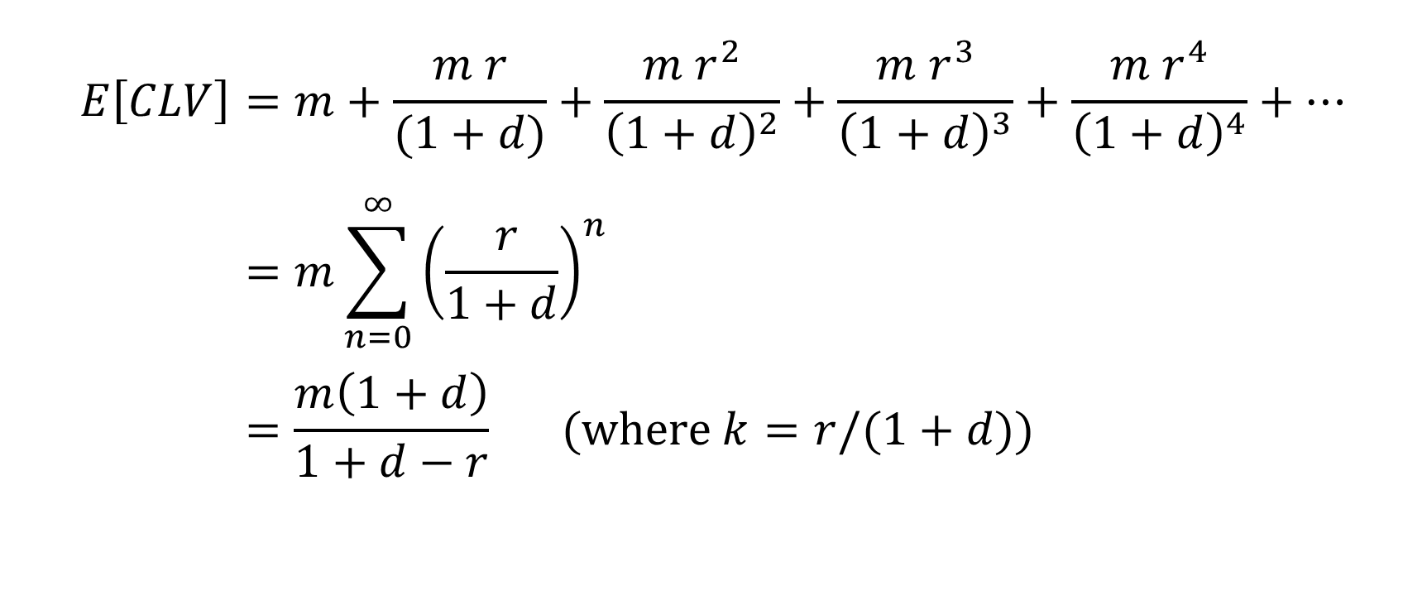
Traditional approach
$$E\left[CLV\right]=m+\frac{m r}{(1+d)}+\frac{m r^{2}}{{\left(1+d\right)}^{2}}+\frac{m r^{3}}{{\left(1+d\right)}^{3}}+\frac{m r^{4}}{{\left(1+d\right)}^{4}}+… \\ =m\sum_{n=0}^{∞}{{\left(\frac{ r}{1+d}\right)}^{n}} \\ =\frac{m\left(1+d\right)}{1+d−r} (\text{where} k=r/(1+d))$$

Slide 9

Our example
$$E\left[CLV\right]=\frac{m\left(1+d\right)}{1+d−r} \\ =\frac{250 \left(1+.01\right)}{1+.01−0.8} \\ =917$$
(If we sum until period 10, our E[CLV] = 889. See spreadsheet.)

Slide 10
CLV vs. residual lifetime value (RLV)
CLV = for a not-yet-acquired customer, from first purchase
RLV = remaining lifetime value of already existing customer, including future purchases

Slide 11
RLV
Discounted to Present
1/(1+d)¹
1/(1+d)²
1/(1+d)³
1/(1+d)⁴
Expected Revenue
$200
$160
$128
$103
Probability of Still Being “Alive”
.8
.64
.51
.41
Margin
$250
$250
$250
$250
…
3
Time (0 is present)
0
2
4
1
Period 1
Period 2
Period 3
Period 4
$$E\left[RLV\right]=\frac{m r}{(1+d)}+\frac{m r^{2}}{{\left(1+d\right)}^{2}}+\frac{m r^{3}}{{\left(1+d\right)}^{3}}+\frac{m r^{4}}{{\left(1+d\right)}^{4}}+…$$

Slide 12
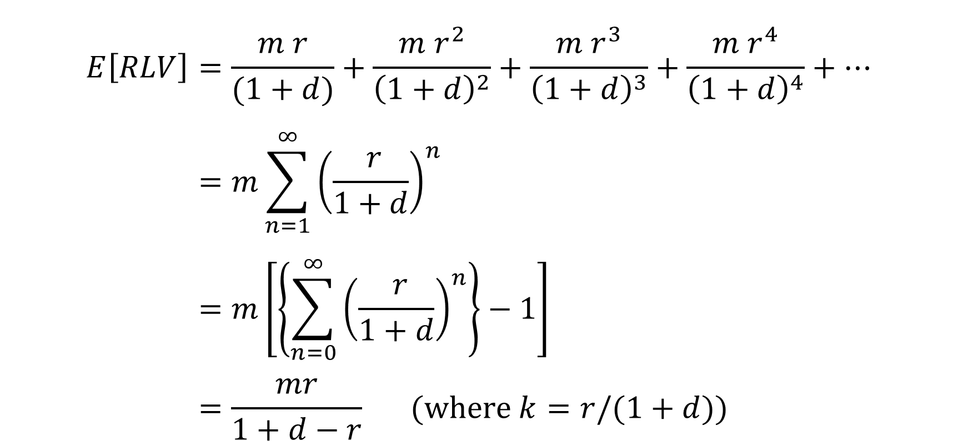
RLV
$$E\left[RLV\right]=\frac{m r}{(1+d)}+\frac{m r^{2}}{{\left(1+d\right)}^{2}}+\frac{m r^{3}}{{\left(1+d\right)}^{3}}+\frac{m r^{4}}{{\left(1+d\right)}^{4}}+… \\ =m\sum_{n=1}^{∞}{{\left(\frac{ r}{1+d}\right)}^{n}} \\ =m\left[\left\{\sum_{n=0}^{∞}{{\left(\frac{ r}{1+d}\right)}^{n}}\right\}−1\right] \\ =\frac{mr}{1+d−r} (\text{where} k=r/(1+d))$$

Slide 13
CLV with profit arriving at the end
Discounted to Present
1/(1+d)¹
1/(1+d)²
1/(1+d)³
1/(1+d)⁴
Expected Revenue
$250
$200
$160
$128
Probability of Still Being “Alive”
.8
.64
.51
Margin
$250
$250
$250
$250
…
3
Time (0 is present)
0
2
4
1
Period 1
Period 2
Period 3
Period 4
$$E\left[RLV\right]=\frac{m}{(1+d)}+\frac{m r}{{\left(1+d\right)}^{2}}+\frac{m r^{2}}{{\left(1+d\right)}^{3}}+\frac{m r^{3}}{{\left(1+d\right)}^{4}}+…$$

Slide 14

CLV with profit arriving at the end
$$E\left[CLV\right]=\frac{m}{(1+d)}+\frac{m r}{{\left(1+d\right)}^{2}}+\frac{m r^{2}}{{\left(1+d\right)}^{3}}+\frac{m r^{3}}{{\left(1+d\right)}^{4}}+…$$
$$=\frac{m}{1+d}\sum_{n=0}^{∞}{{\left(\frac{ r}{1+d}\right)}^{n}} \\ =\frac{m}{1+d−r} (\text{where} k=r/(1+d))$$

Slide 15

Cases
Not yet acquired customer
$$E\left[CLV\right]=\frac{m\left(1+d\right)}{1+d−r}$$
Already acquired customer
$$E\left[RLV\right]=\frac{mr}{1+d−r}$$
Not yet acquired customer, profit arrives at end
$$E\left[CLV\right]=\frac{m}{1+d−r}$$
4. … ?
No one-size-fits-all formula!

Slide 16
Managerial issues
Should we acquire a customer at cost? Up to what costs are we willing to acquire these customers?
Assume a firm spends €2.00 for mailing/printing a catalog, which is sent to 1 million prospects. The response rate is 1%.
Prospects who become customers spend €200 per year, at the beginning of each year.
A customer has a probability of renewing each year of 80%.
The firm also spends €20 per year in marketing to each active customer
The firm has a gross margin of 50% and uses a discount rate of 15%
Should the firm acquire this customer?

Slide 18
What it can CLV do for you?
CLV can:
Tell you what an individual customer is worth (in €’s)
Adding up each customer’s CLV gives you the overall value of your company’s customer equity (CE), which is one way of valuing the company as a whole.

Slide 19
What it can CLV do for you?
CLV can:
Help you better segment your customers
“80/20 rule”, i.e., 80% of CLV come from 20% of the customers.
Platinum (5% of customers): 50% of CLV
Gold (15%): 30% of CLV
Silver (30%): 20% of CLV
Lead (50%): 0% of CLV

Slide 20
Concentration (1)
Line of equality
100%
Concentration in CLV means that a small proportion of customers make a large proportion of total CLV
Higher concentration = greater inequality
A Lorenz curve is used to illustrate the degree of inequality in the distribution of interest
Greater curvature = greater concentration/inequality
cumulative % of total CLV
0%
100%
cumulative % of customers

Slide 21
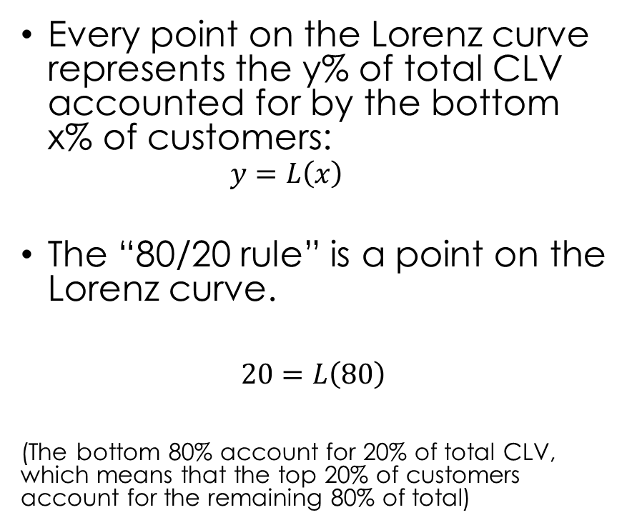
Concentration (2)
Line of equality
100%
Every point on the Lorenz curve represents the y% of total CLV accounted for by the bottom x% of customers:
$$y=L\left(x\right)$$
The “80/20 rule” is a point on the Lorenz curve.
$$20=L\left(80\right)$$
(The bottom 80% account for 20% of total CLV, which means that the top 20% of customers account for the remaining 80% of total)
cumulative % of total CLV
20%
0%
80%
100%
cumulative % of customers

Slide 22
Aside: concentration

Slide 23
What it can CLV do for you?
CLV can:
Tell you what an individual customer is worth (in €’s)
Help you better segment your customers

Slide 24
No one-size-fits-all

Slide 25
Forecasting retention
Consider a subscription company with 1000 customers acquired at the beginning of year 0.
Customer ID | Year 0 | Year 1 | Year 2 | Year 3 | Year 4
1 | 1 | 1 | 1 | 0 | 0
2 | 1 | 1 | 1 | 1 | 0
⁞ | ⁞ | ⁞ | ⁞ | ⁞ | ⁞
999 | 1 | 0 | 0 | 0 | 0
1000 | 1 | 1 | 0 | 0 | 0
Total | 1000 | 631 | 468 | 382 | 326
631 renew once
468 renew twice
326 renew 4 times
382 renew 3 times

Slide 26
Questions
How many customers will survive to years 5, 6, 7 .. ?
What will the retention rate for this cohort be for the next years?
ID | Year 0 | Year 1 | Year 2 | Year 3 | Year 4
1 | 1 | 1 | 1 | 0 | 0
2 | 1 | 1 | 1 | 1 | 0
⁞ | ⁞ | ⁞ | ⁞ | ⁞ | ⁞
999 | 1 | 0 | 0 | 0 | 0
1000 | 1 | 1 | 0 | 0 | 0
Total | 1000 | 631 | 468 | 382 | 326

Slide 27







Survivor function
Survivor function $S(t)$ is the proportion of cohort that is still a customer beyond $t$.
Year 1 | Year 2 | Year 3 | Year 4 | Year 5
1000 | 631 | 468 | 382 | 326
$$t=0$$
$$t=1$$
$$t=2$$
$$t=3$$
$$t=4$$
$$t=5$$

Slide 28

Retention rate
Retention rate $r(t)$ is the proportion of cohort retained from $t−1$.
Year 1 | Year 2 | Year 3 | Year 4 | Year 5
1000 | 631 | 468 | 382 | 326
$$t=0$$
$$t=1$$
$$t=2$$
$$t=3$$
$$t=4$$
$$t=5$$

Slide 29





$$S(0)=\frac{1000}{1000}$$
$$S(1)=\frac{631}{1000}$$
$$r(2)=\frac{468}{631}$$
$$S(2)=\frac{468}{1000}$$
$$r(1)=\frac{631}{1000}$$

Slide 30


Survivor function and retention rate
$$r(t)=\frac{S\left(t\right)}{S\left(t−1\right)}$$
$$S(t)=r\left(1\right)×r\left(2\right)×⋯r\left(t\right)$$
$S\left(t\right)=\prod_{i=1}^{t}{r\left(i\right)}$
$S\left(0\right)=1$
“product”
We can build a model of the survivor function and
use it to predict the retention rate

Slide 31
Projecting retention
So far, we have summarized data
To project retention into the future, we need to build a prediction model.

Slide 32
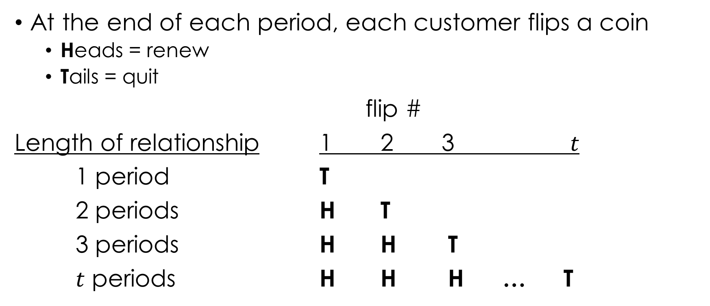
Geometric model
At the end of each period, each customer flips a coin
Heads = renew
Tails = quit
flip #
Length of relationship 1 2 3 $t$
1 period T
2 periods H T
3 periods H H T
$t$ periods H H H … T

Slide 33
Aside: probability models
In reality, no one flips a coin to decide whether to renew or quit
Paramorphic representation of consumer behavior:
These models are paramorphic in the sense that while they might predict quite well, they are not to be construed as models of what the consumer is really doing. That is, decision makers may behave as if they are flipping coins but that does not mean that, in fact, they are.
Useful placeholder for stuff we cannot explain.

Slide 34
Group exercise
Come up with a subscription business model for a new category
Each member flip a coin, recording the number of times until you get tails.
Use this information to construct for your group a graph of the survivor function and retention rate.
Example coin flips
A: 4
B: 1
C: 2
D: 2
E: 3
Notes:
A: 4
B: 1
C: 2
D: 2
E: 3

Slide 35





Geometric model (p=0.5)
flip #
Length of relationship 1 2 3 $t$ prob
1 period T
2 periods H T
3 periods H H T
$t$ periods H H H … T
$$=\left(\frac{1}{2}\right)$$
$$=\left(\frac{1}{2}\right)×\left(\frac{1}{2}\right)$$
$$=\left(\frac{1}{2}\right)×\left(\frac{1}{2}\right)×\left(\frac{1}{2}\right)$$
$$=\left(\frac{1}{2}\right)×\left(\frac{1}{2}\right)…×\left(\frac{1}{2}\right)$$

Slide 36






Geometric model (p=0.2)
flip #
Length of relationship 1 2 3 $t$ prob
1 period T
2 periods H T
3 periods H H T
$t$ periods H H H … T
$$=\left(0.2\right)$$
$$=\left(0.8\right)×\left(0.2\right)$$
$$=\left(0.8\right)×\left(0.8\right)×\left(0.2\right)$$
$$=\left(0.8\right)×\left(0.8\right)…×\left(0.2\right)$$
$$P(T=t|θ)=θ{\left(1−θ\right)}^{t−1}$$
$$t=1, 2, …$$
$$S(t)=P(T>t|θ)={\left(1−θ\right)}^{t}$$

Slide 37






Estimating parameters
Year 1 | Year 2 | Year 3 | Year 4 | Year 5
1000 | 631 | 468 | 382 | 326
$$t=0$$
$$t=1$$
$$t=2$$
$$t=3$$
$$t=4$$
$$t=5$$
# Lost
369
163
86
56
???

Slide 38
Likelihood
Likelihood is defined as the probability of observing the data for a given set of unknown model parameters.
We don’t know theta; we want to pick the one that closest matches the data.
For a given dataset, the maximum likelihood estimates of the model parameters are those that maximize L.

Slide 39







Estimating parameters
Year 1 | Year 2 | Year 3 | Year 4 | Year 5
1000 | 631 | 468 | 382 | 326
$$t=0$$
$$t=1$$
$$t=2$$
$$t=3$$
$$t=4$$
$$t=5$$
# Lost
369
163
86
56
???
$$P(T=1|θ)$$
$$P(T=2|θ)$$
$$P(T=3|θ)$$
$$P(T=4|θ)$$
$$P(T>4|θ)$$
$$\text{L}\left(θ\right)={P(T=1|θ) }^{369}×{P(T=2|θ) }^{163}×{P(T=3|θ) }^{86}×{P(T=4|θ) }^{56}×{S(4|θ) }^{326}$$
$\text{L}\left(θ=0.2\right)=6$ $×{10}^{−647}$
$\text{L}\left(θ=0.5\right)=1.4$ $×{10}^{−747}$

Slide 40



Log-likelihood
In practice we take the logarithm of L because it’s easier to maximize.
$\text{L}\left(θ=0.2\right)=6$ $×{10}^{−647}$
$\text{L}\text{L}\left(θ=0.2\right)=log⁡(6$ $×{10}^{−647})=−1488.0$
$\text{L}\left(θ=0.5\right)=1.4$ $×{10}^{−747}$
$\text{LL}\left(θ=0.5\right)=log⁡(1.4$ $×{10}^{−747})=−1719.7$
$$LL\left(θ\right)=369×log⁡\left(P(T=1|θ\right))$$
$$+163⁡\left(P(T=2|θ\right))$$
$+86×log⁡\left(P(T=3|θ\right))$
$$+56×log⁡\left(P(T=4|θ\right))$$
$$+326×log⁡\left(S(4|θ\right))$$

Slide 41
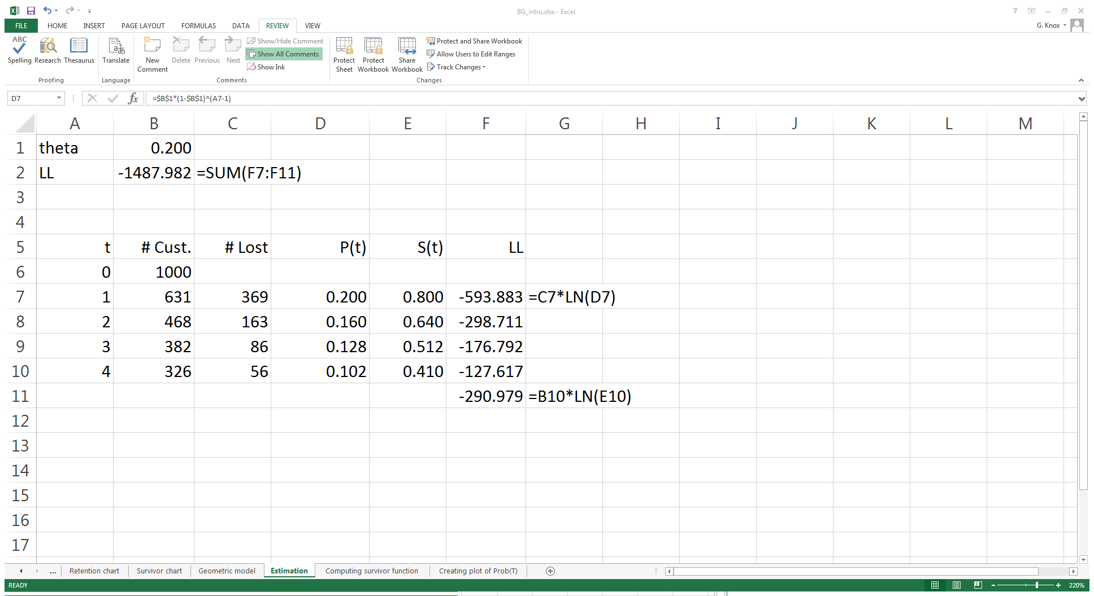
Estimating parameters (1): Excel
=$B$1*(1-$B$1)^(A7-1)
=(1-$B$1)^A7

Slide 42
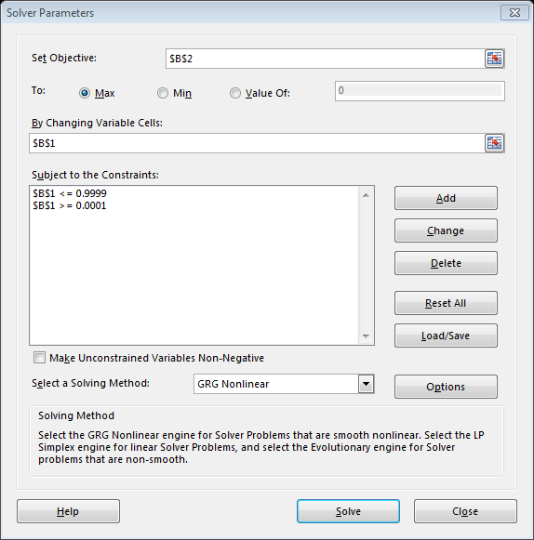
Estimating Parameters (2): Excel
Want to maximize it
Log-Likelihood
By changing theta
Subject to these constraints
Hit “Solve”

Slide 43
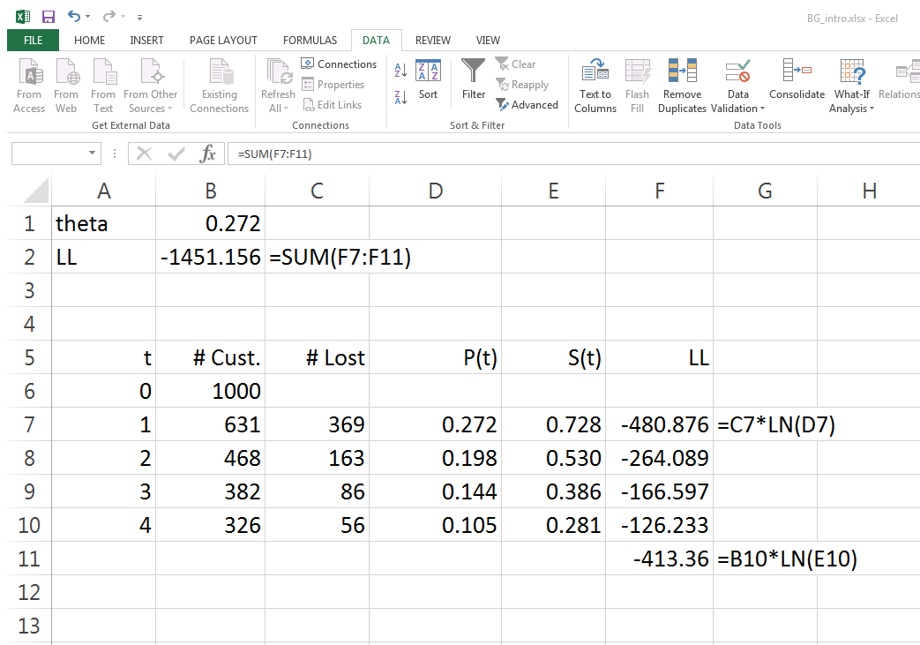
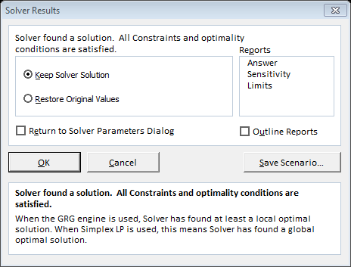
Estimating parameters (3): Excel
“best” estimate of theta (maximum likelihood estimate)

Slide 44
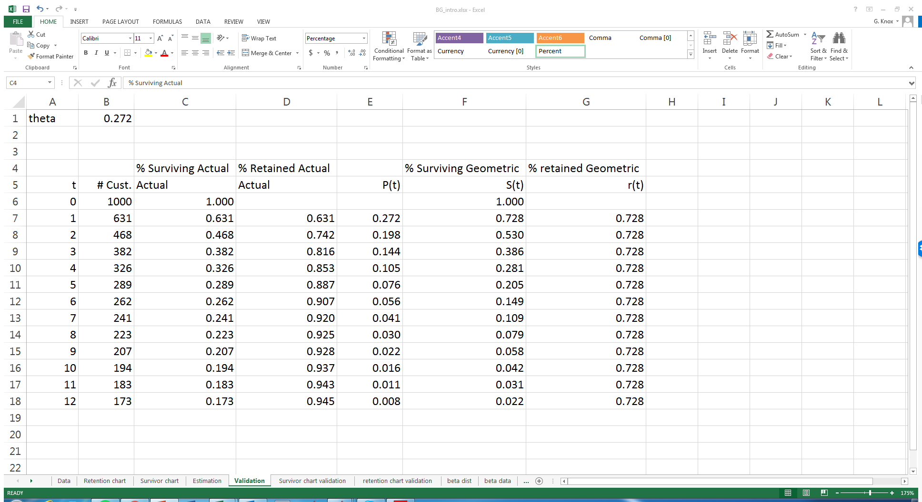
Projecting survival and retention curves
=B7/$B$6
=(1-$B$1)^A7
=B7/B6
=F7/F6

Slide 45
Projecting survival & retention curves (2)
What’s wrong with this story?

Slide 46
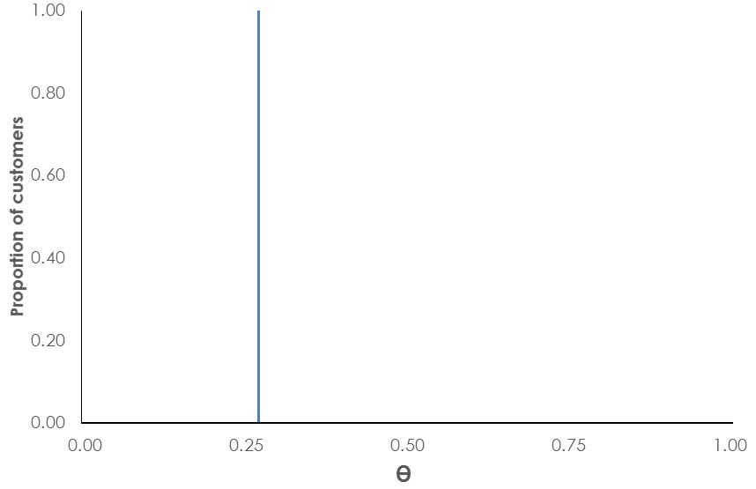
What’s wrong with this story?

Slide 47
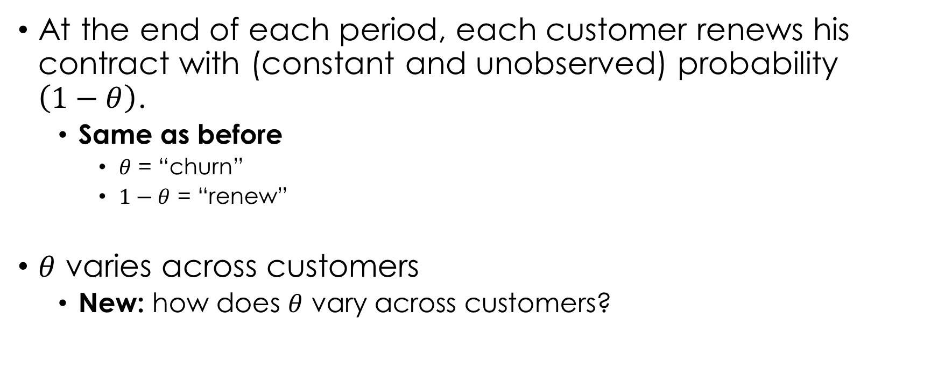
Building a better model
At the end of each period, each customer renews his contract with (constant and unobserved) probability $\left(1−θ\right)$.
Same as before
$θ$ = “churn”
$1−θ$ = “renew”
$θ$ varies across customers
New: how does $θ$ vary across customers?

Slide 48
Next time (Monday)
How do we incorporate heterogeneity in “churn rates”?
Beta distribution
Integrating over probability distributions
Change in syllabus
Fader and Hardie (2007a), especially p. 80-90 (App. A & B)
Worth re-reading in preparation for Monday’s class
Introduction to Assignment 1

